Slide 1

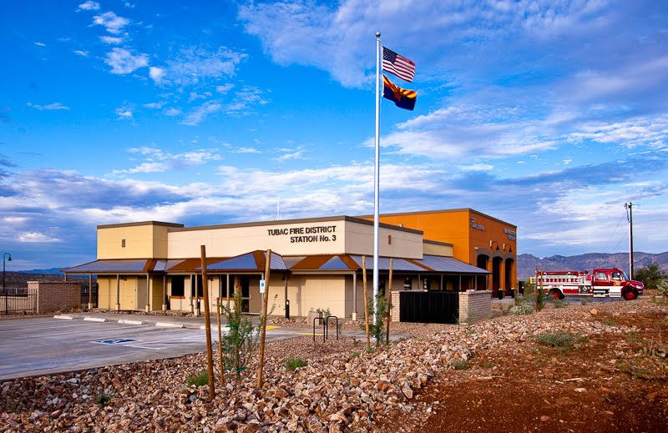

Financial Report
September 2026

Slide 2

September 2026
Notes:
Total Revenues are $436K which is over budget by $232K
Tax Levy is $121K and Non Tax Levy is $111K over budget. The non tax levy is related to the timing of the USDA grant reimbursement of $76K, EMS of $16K and interest earnings of $5K of additional revenue over budget.
Total Expenses are $314K for the month which is under budget by $49K. All categories of costs are below budget for the month of Feburary.

Slide 3
Fiscal Year to Date Budget to Actual
Notes:
YTD Revenues are $5.3M which is over budget by $536K
Tax levy is about $93K of that variance and Non Tax Levy is making up the other $443K. The main drivers of that non tax levy revenue over drive is related to wildland revenue of $124K, the timing of the USDA reimbursement of $76K and Interest Income of $70K. In addition, we have approximately $72K of misc revenue that is related to credits for our EMI health as well as Workers Compensation. As well as the VFIS insurance claim revenue to reimburse for vehicle repair work done.
Total expenses YTD are $3.2M which is $198K under budget. All categories of costs are under budget with the exception of vehicle equipment and training. Vehicle equipment is due to the increase costs for the repair work that was done which is offset by that VFIS insurance claim revenue we saw earlier. The training costs are over budget due to the timing of the CEP training as well as tuition reimbursement.

Slide 4
Percentage of Expenses Year to Date
Notes:
As far as percentage of expenses year to dat we are seeing 77% of our costs are related to personnel, with operations at 15% managerial at 5% and communications is at 3%

Slide 5
Cash Position
Notes:
Cash position, we ended the month with $11,866,842 of cash in the bank which is an increase from this time last year of $300K. Which is good news but was is even better news is that it also is accompanied with and increase of other assets of 2.2M which is related to increase fixed assets, and lower liabilities due to the pay down of debt. All of which helps increase our overall cash position.

