Slide 1


Staff Report
Tubac Fire Board
August 2024
Tubac Fire District is committed to the safety of our community through the delivery of fire suppression, medical services, and public education.

Slide 2
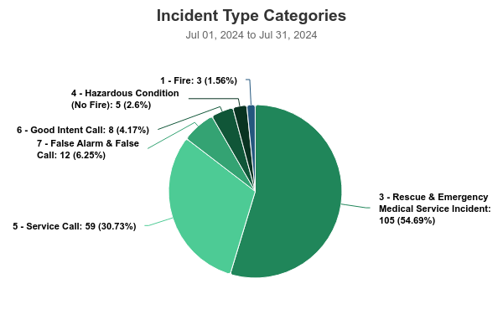
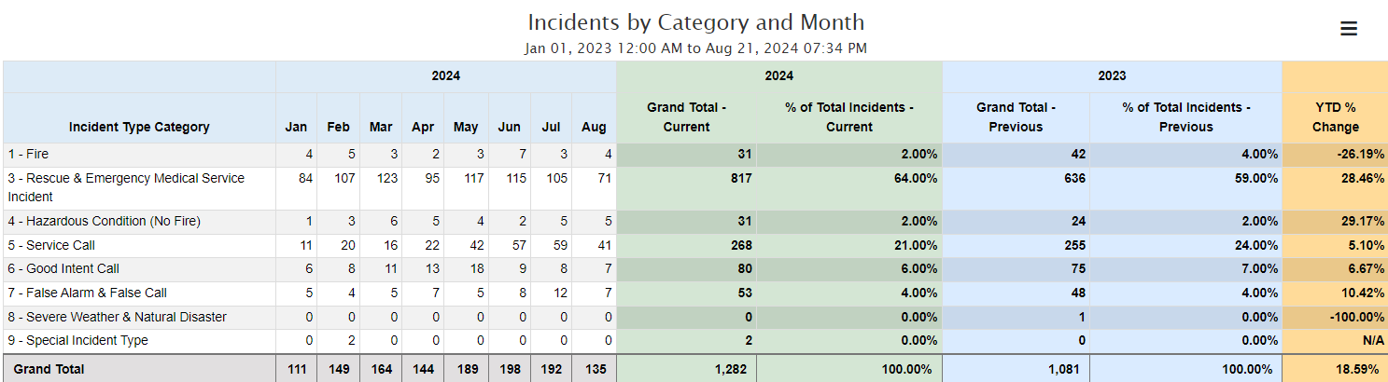
July Emergency Responses
EMS 105 (54 Transports, 2 Transfer of care to Air ambulance)
Fire 20
Public Assist 67_
Total Calls 192

Slide 3
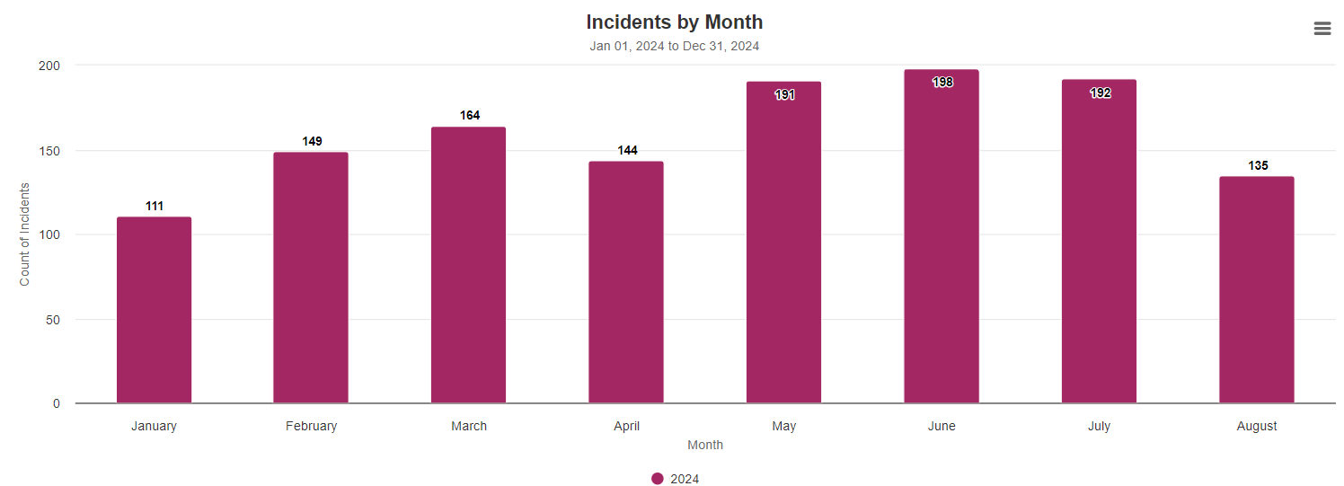
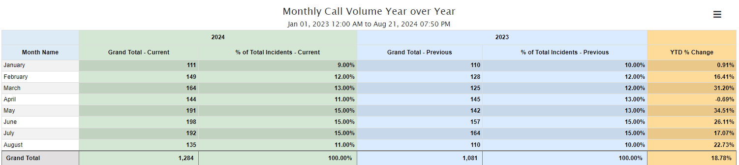
YTD Call Volume

Slide 4
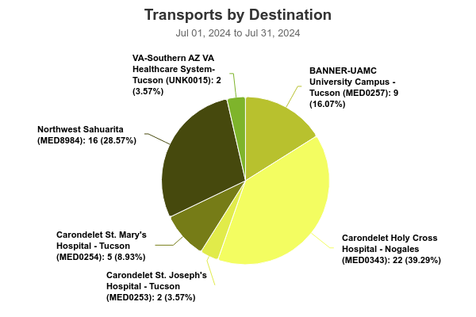
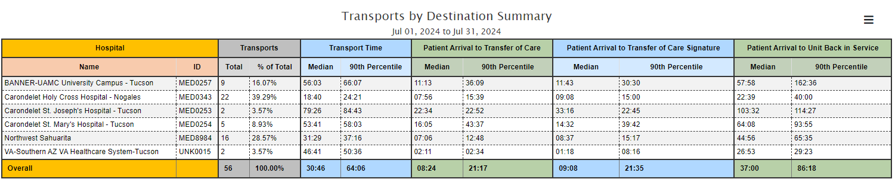
July Ambulance Transports by Destination

Slide 5
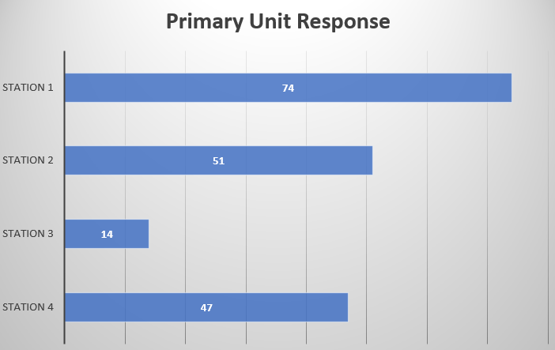
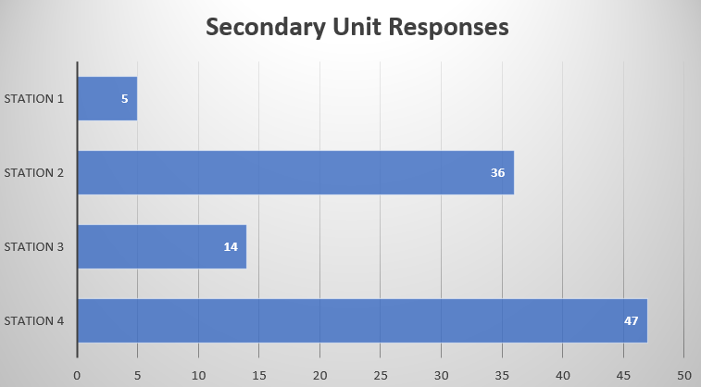
July Emergency Responses By Station
Primary Responses by Station
Station 1 74
Station 2 51
Station 3 25
Station 4 42
Secondary Responses by Station
Station 1 5
Station 2 36
Station 3 14
Station 4 47

Slide 6
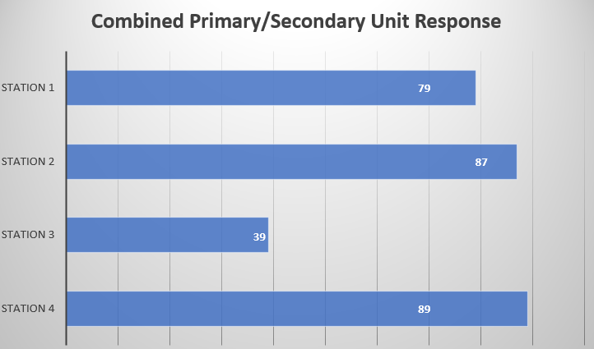
July Combined Primary/Secondary Unit responses by station
Station 1 79
Station 2 87
Station 3 39
Station 4 89

Slide 7
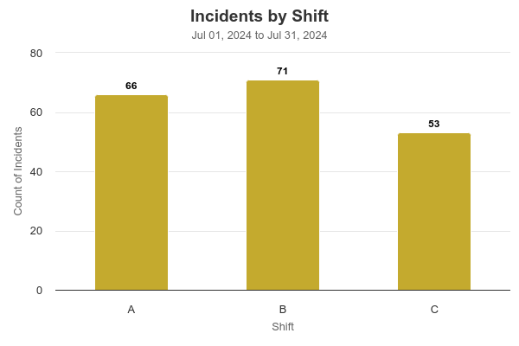
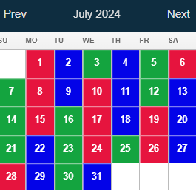
July Incidents by shift
A Shift
B Shift
C Shift
A Shift 66
B Shift 71
C shift 53

Slide 8

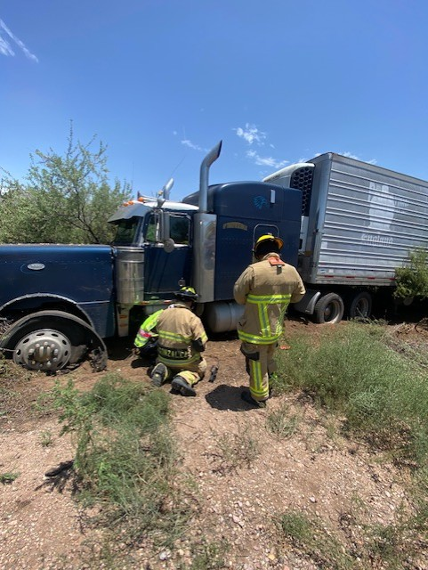
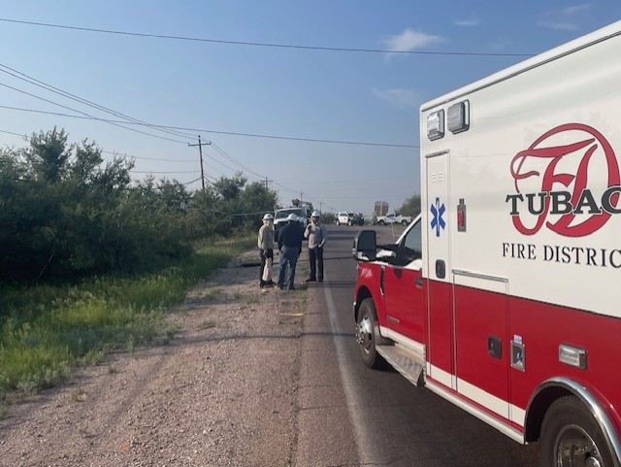
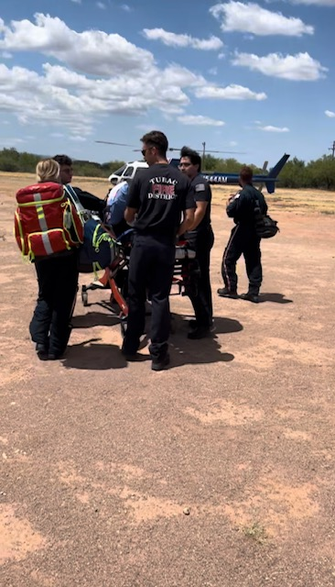
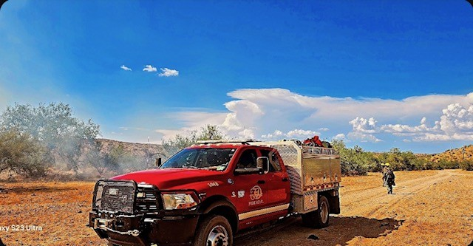
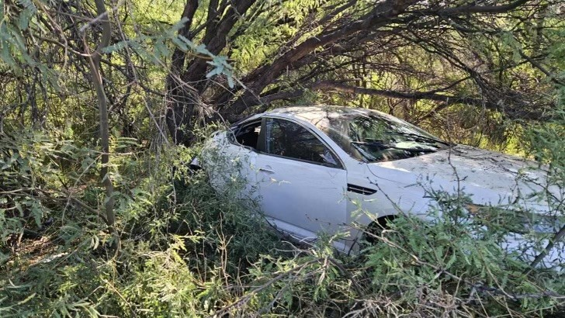
Significant Calls
Crews responded to a residence for a reported fall injury. Upon arrival, they discovered that the patient had not fallen but was suffering from a heat stroke. The patient then went into cardiac arrest and unfortunately, the crew was not able to resuscitate the patient.
The crew responded to a significant call involving an elderly male experiencing chest pains and shortness of breath. An EKG indicated an anterior MI, and the patient was airlifted to a nearby hospital for further treatment
Crew responded to the area of West Frontage Road near Station 2 for a large commercial truck that caught power lines crossing over the road, causing severe damage to one of the power poles. Road closures were in effect from Camino Agosto to Avenida Papalote.
On Saturday morning, crews responded to Mount Hopkins Road, where several unresponsive cyclists were found after an accident. One critical patient was airlifted to a trauma center, another was transported by ground, and a third left before receiving care.

Slide 9

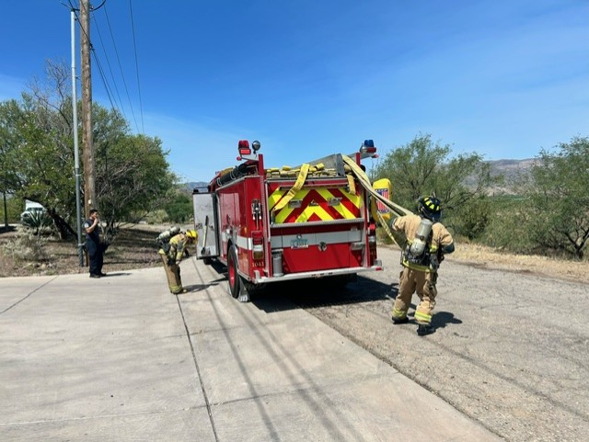
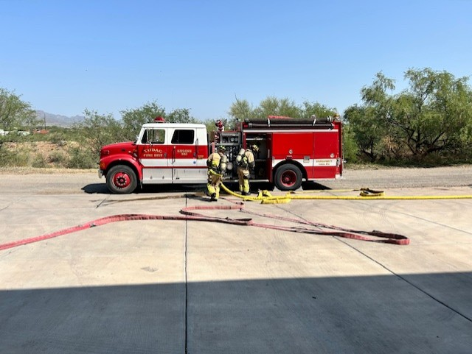
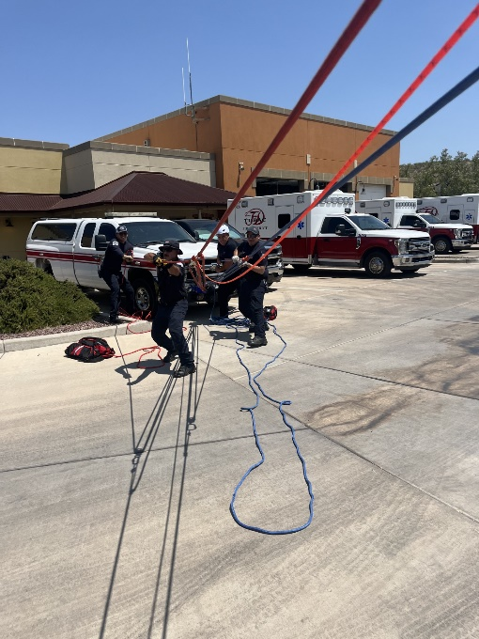
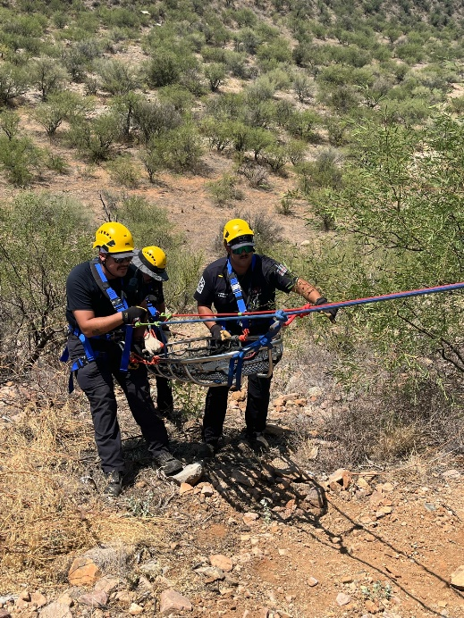
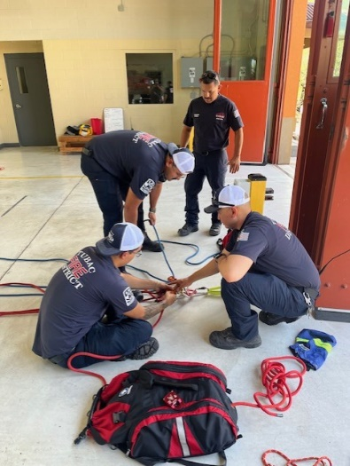
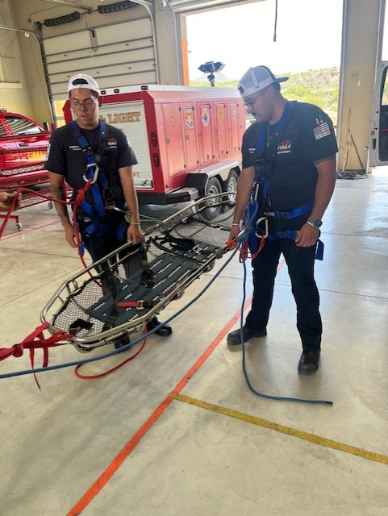
Training
Rope Rescue: mechanical advantage systems, low to medium angle rescue.
Hoisting Operations
Ladder Operations
Multi Agency drill at Rio Rico Resort

Slide 10
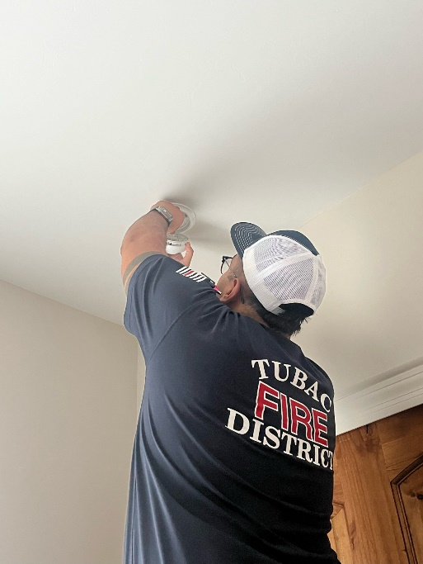
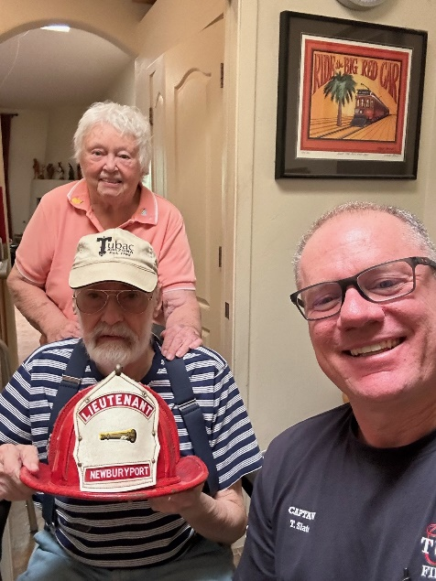
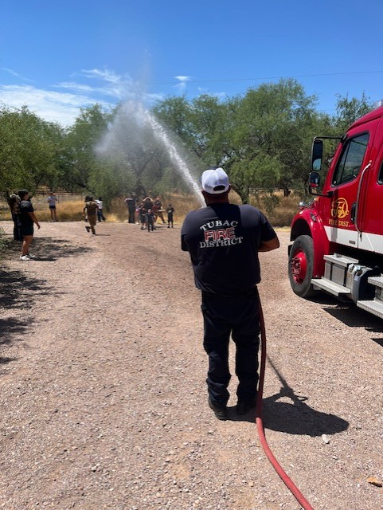
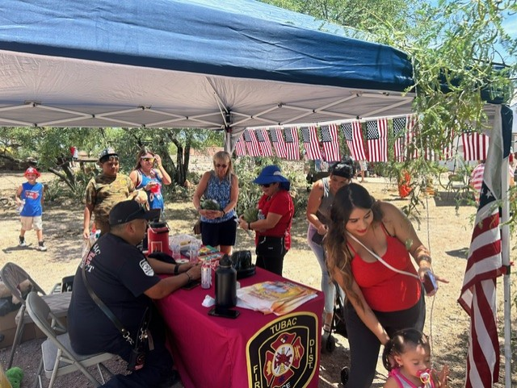
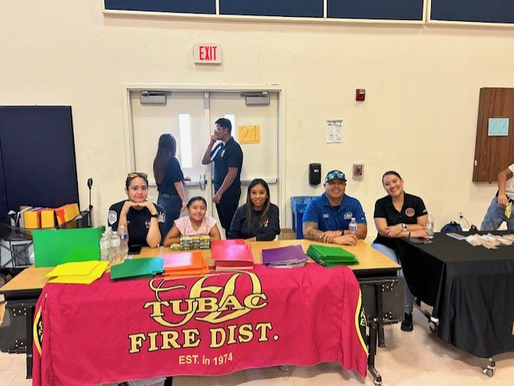
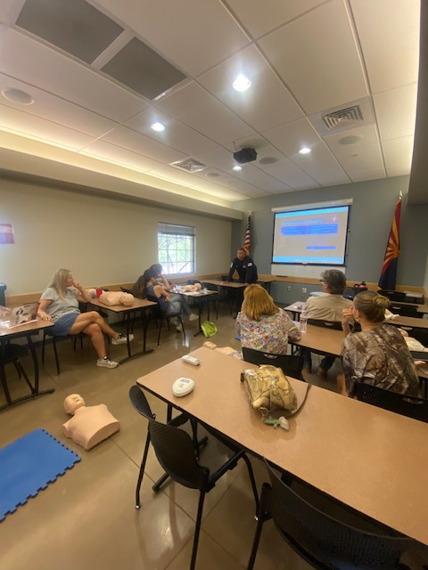
Public Education/Fire Prevention and Events
Attended 4th of July Parade in Nogales
Attended 4th of July Celebration at the Tubac Presidio
Tubac Fire participated in the Back-to-School Blitz where over 500 students received school supplies
Tubac Fire received recognition from Santa Cruz County Office of Emergency Management for teaching and inspiring the youth of Santa Cruz County

Slide 11
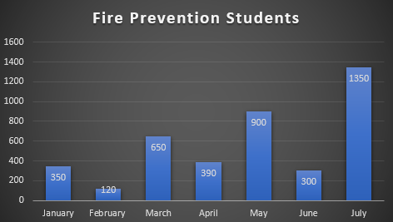
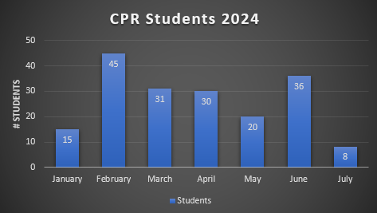
Fire Prevention and CPR Classes

Slide 12
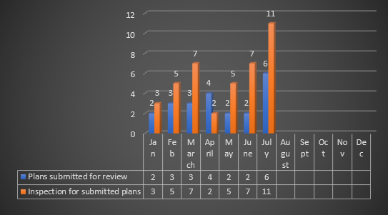
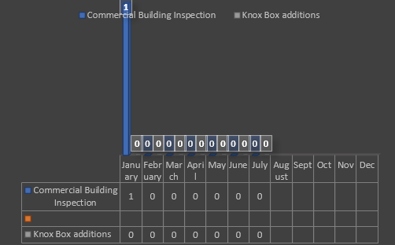
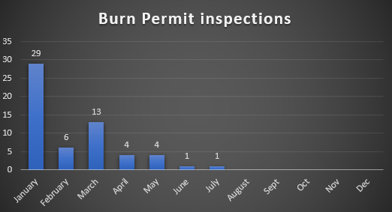
Plans Review & Inspections

Slide 13
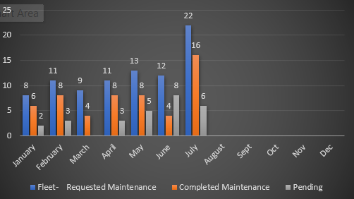
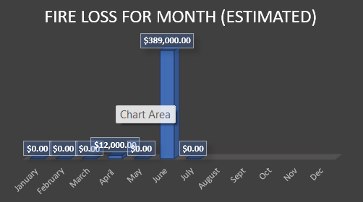
Maintenance Requests
Fire Loss Due To Incident

