Slide 1
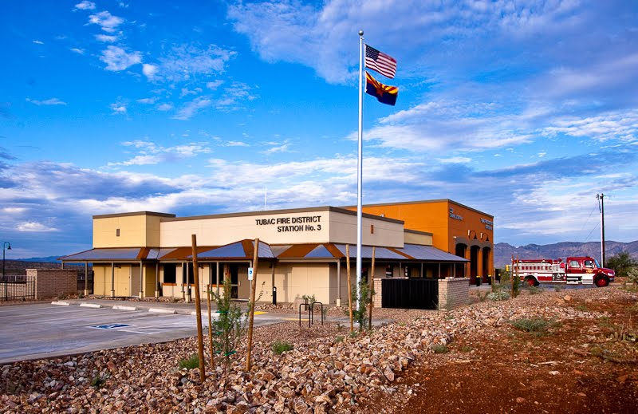

Fiscal Year 2020/2021 Budget Workshop
April 29, 2020

Slide 2
Objectives
Budget Schedule
Overview of District Revenues
Overview of District Expenses
Tax Rate and Homeowner Impact
Summary Budget
Discussion and Questions from the Board

Slide 3
Budget Schedule
March Staff budget workshop
April 29
Budget workshop with Fire Board
March – May
Meet with various vendors and determine actual costs of benefits, property casualty insurance renewal, etc.
February - March Meeting with program managers to discuss strategic plan and other budget priorities and issues and to seek employee input concerning budget priorities
May 27
Budget workshop with Fire Board & Tentative Adoption
June 24
Public Hearing on Budget and Final Adoption
March 25
Initial Board workshop

Slide 4
Budgeted Revenues
Property Tax Revenue - $ 2,598,142
  Tax Rate $2.8500 no change
  AV $91,162,883 increase of 4.95%
  FDAT - $132,480
  Increase of $2,035
  EMS - $450,000
  Increase of $35,000
  Wildland - $405,000
  No change
  Budgeted related personnel and travel expenses
  Projected profit to fund capital reserve
  Tower - $197,100
  Increase of $10,100
Other Income - $37,000 (Air Methods station rental, interest and grant income, etc.)

Slide 5
Budgeted Expenses
Overview
  Personnel Expenditures
    Step Increase and Medic II Position
    PSPRS Contribution Rate increased to 27.33%
    Workers Comp budget includes amount from 7710 Insurance
  Operational Expenditures – Developed based on requests and historical usage
    Buildings and Land
      Added funding for temporary facilities lease
    Vehicle and Equipment
      Increased based on maint expenses
      Enterprise Lease Agreement
      Increased equipment testing
  Operational Expenditures Cont’d
    Communications/IT
      Increase for Phase 1 Funding on Communications upgrades
      Needed Computer upgrades
      Software Consolidated to one line item
    Travel & Training
      Support existing training programs and funding for paramedic training
    Managerial Expenses
      Decreased Accounting based on actual usage
      Increased funding for legal/professional fees
  Restricted Funds
    Continued growth and development of capital fund

Slide 7
DRAFT Budget FY2021

Slide 8
Board Discussion & Questions

